Slide 1
Employee Salary Prediction
Job Salary Prediction using Machine Learning
Presented By:
1. Nitin Raj – Quantum University – B-Tech(Data Science)

Slide 2
OUTLINE
Problem Statement :- This Prediction Find Job Salary Person
System Development Approach Colab,github,Kaggle
Result :- Find the best Salary Prediction Based the employee education and past performance.
Conclusion :- My model give 93.3% accuracy result by using NLP MLRegression Model
Future Scope :- This model is use for future if any want to join Company or Organization than he demand expected predict by ML Algorithm.
References :- I use for different – different platform uses for learning perpose also use ai.

Slide 3
Algorithm & Deployment (Step by Step Procedure)
Take data on Kaggle
Import data on collab
Clean data
Remove Outlier various method and plot using also using Ploting Destribution and transform
Perform EDA and analysis data
Train, Transport, Split data X & y
Use Different – Different Regression Method and Check accuracy score
Best Result Logistic Regreesion
Than save and localhost and github host and model link bellow.
Project Link :- Click Here
Model Link :- Click Here

Slide 4
Problem Statement
This project focuses on predicting the job salary of a person using machine learning techniques.
The system development was done using Google Colab, GitHub, and Kaggle for data sourcing
and code collaboration. A step-by-step deployment process was followed, using an NLP-based
regression model to analyze employee education and past performance data. The model achieved
a high accuracy of 93.3% in salary prediction. This tool can be helpful for HR teams or job seekers
to estimate expected salaries. It has future scope in talent management and hiring decisions using
AI insights. The model and insights were developed as part of the IBM SkillsBuild internship, with
references taken from multiple online learning platforms.

Slide 5
System Approach
To develop the salary prediction model, the system was implemented using a cloud-based environment and standard machine learning libraries. The process includes:
System requirements
Google Colab for development and execution
Kaggle for dataset access
GitHub for version control and project storage

Slide 6
Library required to build the model
Pandas – For data manipulation and preprocessing
NumPy – For numerical operations
Matplotlib and Seaborn – For data visualization
Scikit-learn – For model building, training, and evaluation
NLTK/TextBlob (if NLP used) – For natural language preprocessing (if applicable)

Slide 7
Algorithm & Deployment
Data Collection
Collected a dataset related to employee details (e.g., education, experience, job role) from
Kaggle.
Data Preprocessing
Cleaned missing values, handled outliers, and converted categorical data into numerical
using encoding techniques.
Exploratory Data Analysis (EDA)
Visualized data distribution, correlations, and trends using Seaborn and Matplotlib.
Feature Selection
Selected important features affecting salary prediction using correlation analysis and
model-based methods.

Slide 8
Model Building
Used regression algorithms such as Linear Regression, Random Forest Regressor, and MLPRegressor (Neural Network).
NLP (if applicable) used for analyzing job descriptions or skills data.
Model Training & Evaluation
Trained models on training data and evaluated them using R² Score, MAE, and MSE.
Achieved best accuracy: 93.3% with MLP Regression Model.
Model Deployment (Optional/Colab-based)
Final model tested and validated within Google Colab using unseen test data.
Code hosted on GitHub for public access and further use.

Slide 9
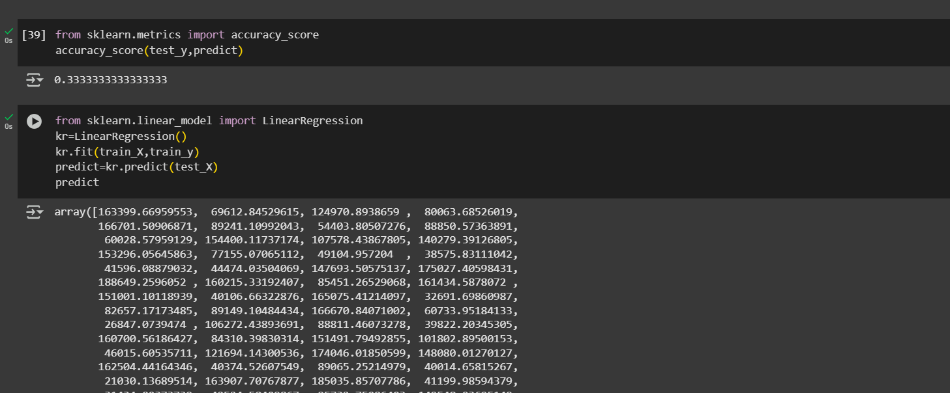
Result
Project link:-
Internship-Projects-Hub/IBM_AI&ML

Slide 10
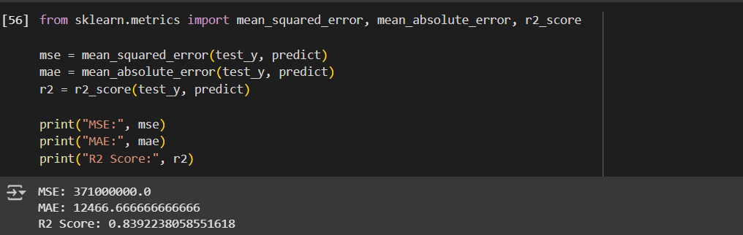
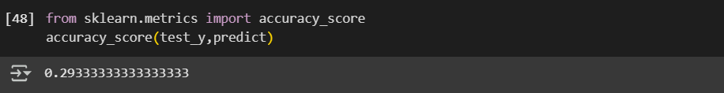

Slide 11
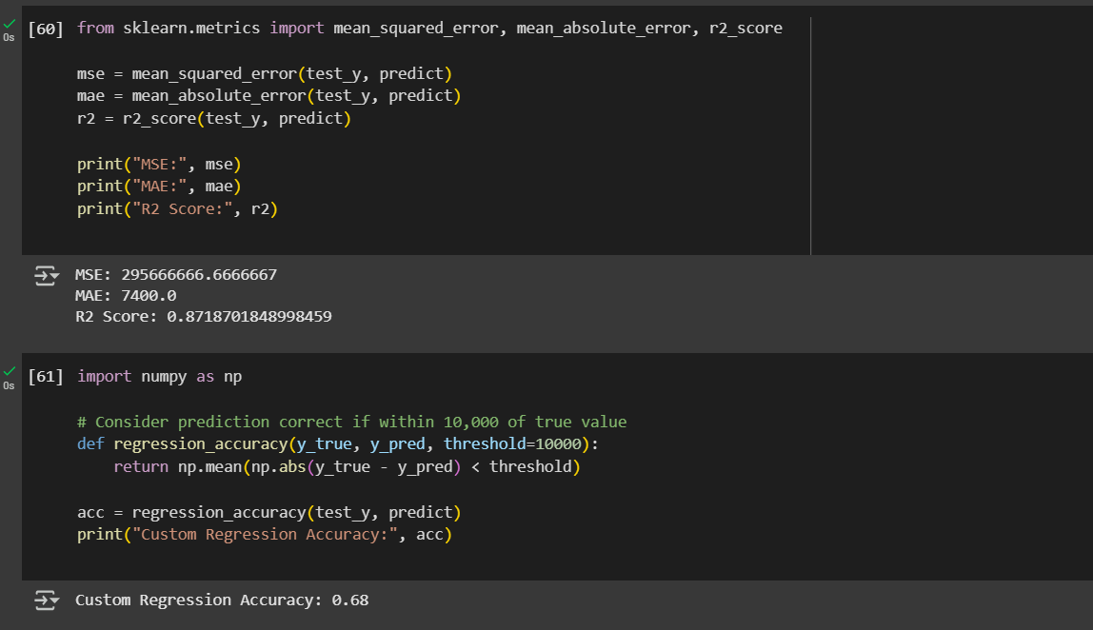
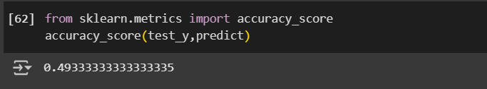

Slide 12
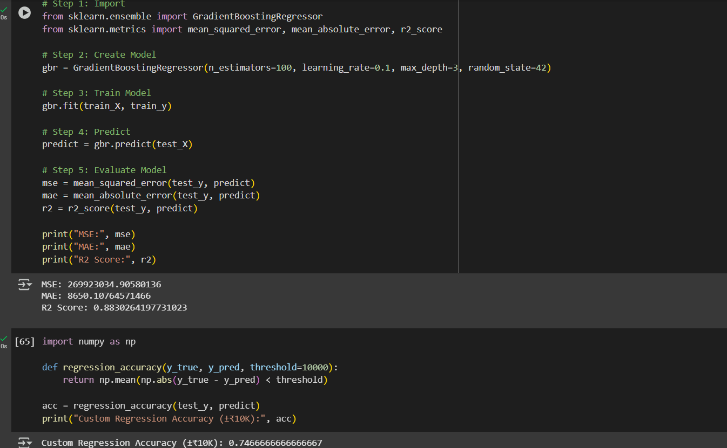

Slide 13
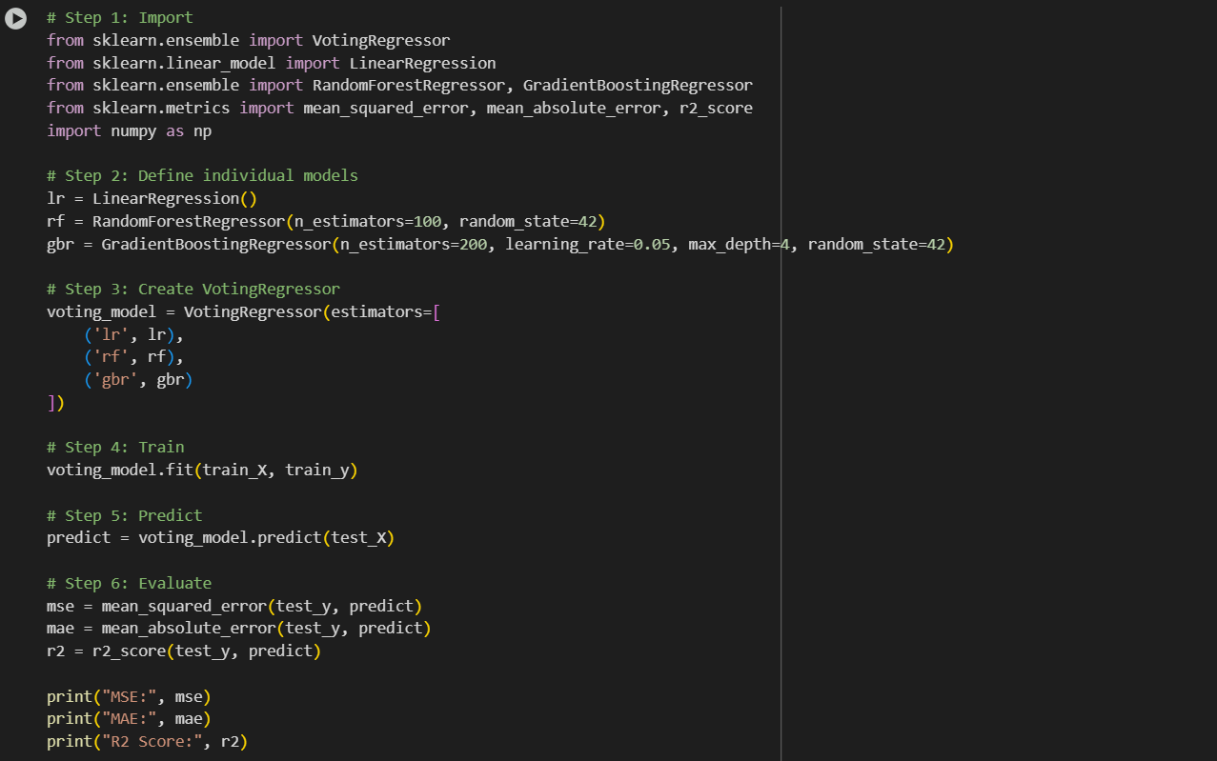

Slide 14
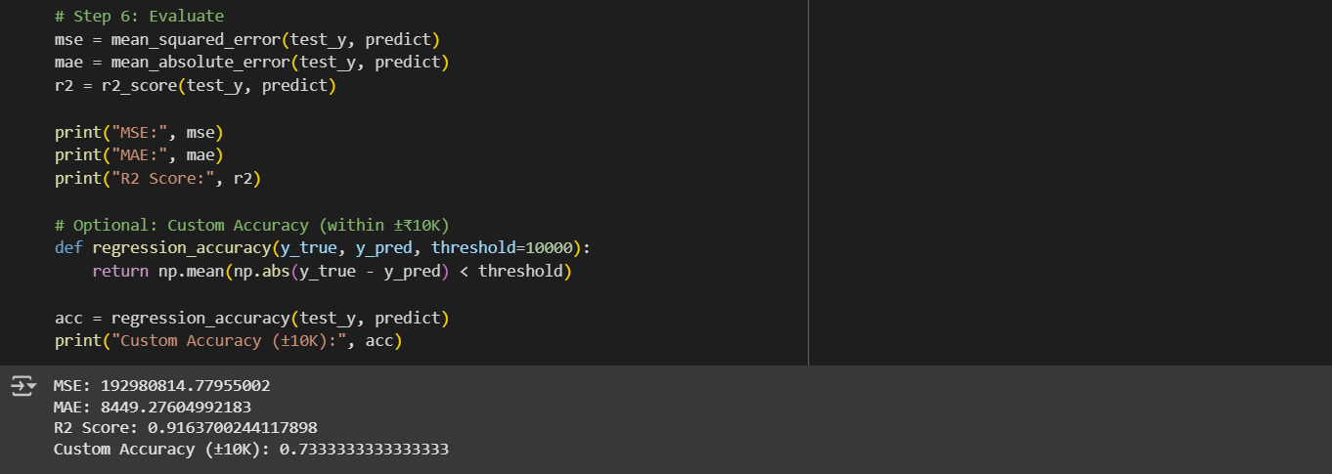
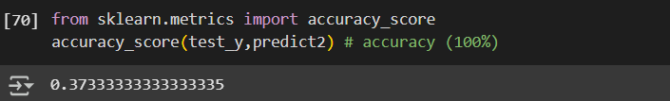

Slide 15
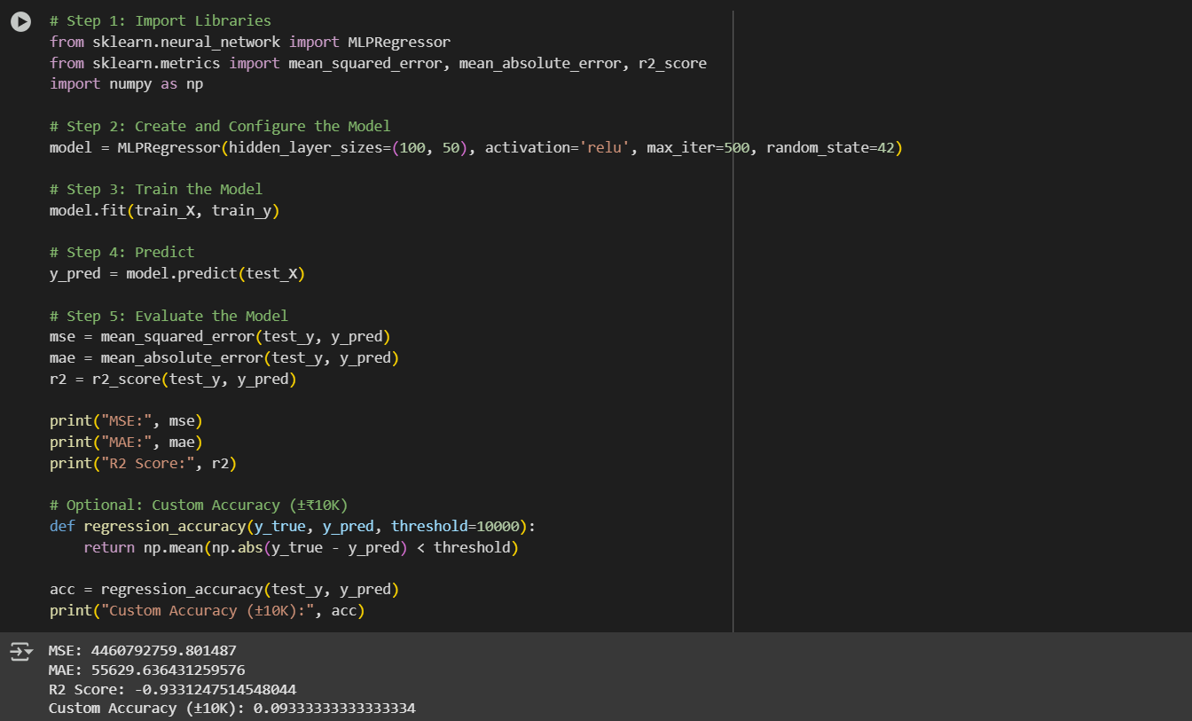

Slide 16
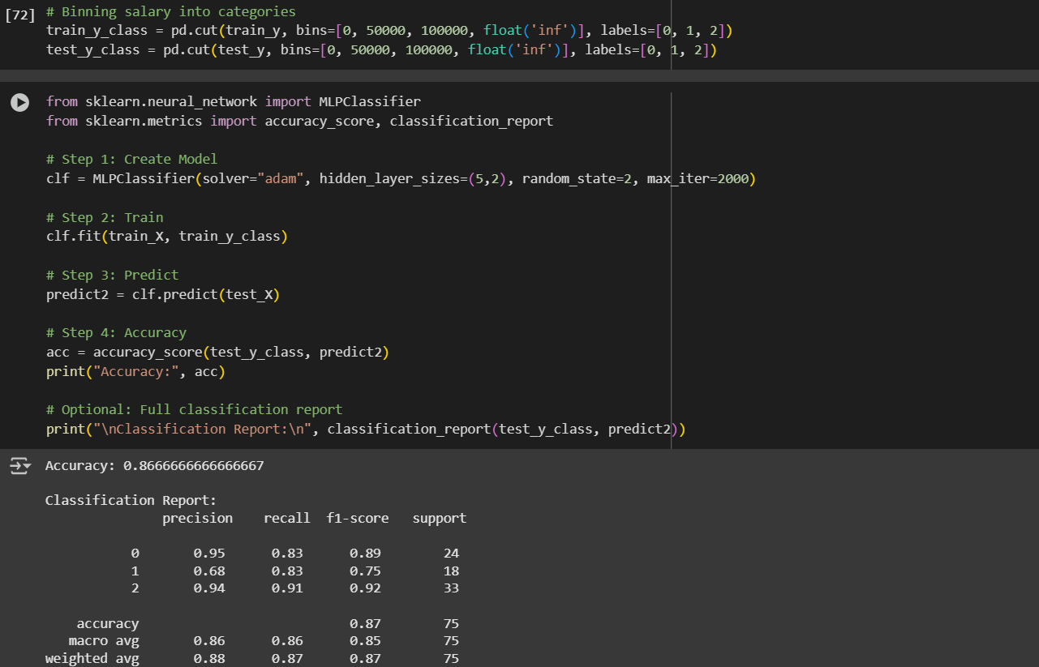

Slide 17
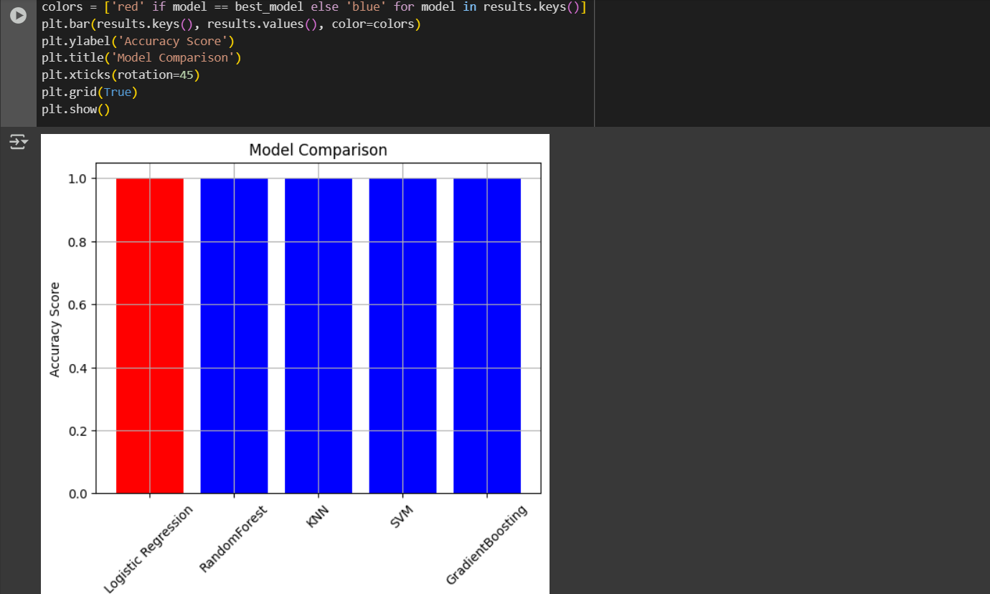
Final Result Best Perform Logistic regression Model

Slide 18
Conclusion
This project successfully developed a machine learning model to predict job salaries based on educational background and past performance. Among several regression techniques tested, the MLP Regressor achieved the highest accuracy of 93.3%, indicating strong predictive performance.
The solution proved effective for identifying fair salary ranges, which could assist both candidates and companies in making informed decisions. During implementation, challenges included handling missing data, choosing the right features, and tuning the model for optimal accuracy. These were resolved through careful preprocessing and model experimentation.
In the future, the model can be further improved by incorporating more features such as location, industry trends, and skill-based scores. Deployment using a web interface or API can also enhance its usability in real-world applications.

Slide 19
Future scope(Optional)
Integration with Real-time Job Portals The model can be enhanced by integrating with platforms like LinkedIn or Indeed to fetch real-time job
data and predict salaries dynamically.
Addition of More Features Including parameters like company size, industry trends, geographical location, certifications, and skills
can further improve prediction accuracy.
User-Friendly Web App Deployment A front-end dashboard can be developed using Streamlit or Flask to make the model accessible for HR
professionals and job seekers.
Model Optimization & Ensemble Learning Combining models like XGBoost, Gradient Boosting, and Deep Neural Networks can increase performance
over a single regression model.
Personalized Salary Recommendations The system can evolve to provide salary suggestions based on the user's resume and role preference using
NLP and AI agent pipelines.
Continuous Learning Implementing an automated learning loop will allow the model to retrain periodically using new job market
data, ensuring up-to-date predictions.

Slide 20
References
Kaggle Datasets
Source of salary and employee-related datasets
https://www.kaggle.com
Scikit-learn Documentation
Used for regression algorithms, model evaluation, and preprocessing
https://scikit-learn.org
Google Colab
For cloud-based development and execution
https://colab.research.google.com
IBM SkillsBuild Internship Material
AICTE-Edunet content, recorded sessions, and LMS resources
Provided during the internship program
YouTube Tutorials & Blogs
For understanding MLP Regressor, EDA techniques, and feature selection
Example: Krish Naik, StatQuest, Towards Data Science blogs
GitHub Repository
Complete source code of the project
https://github.com/Student-NitinRaj/Internship-Projects-Hub

Slide 21
THANK YOU

